Slide 1
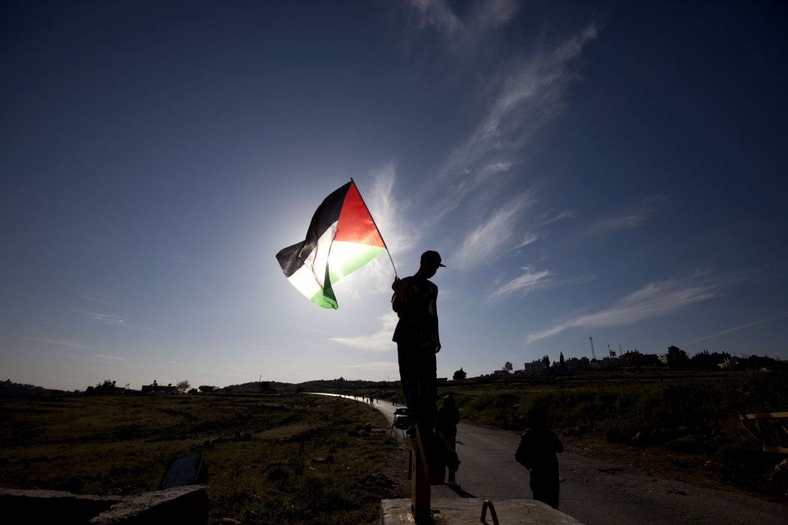

Palestine: A Brief History & Campaigns

Slide 2
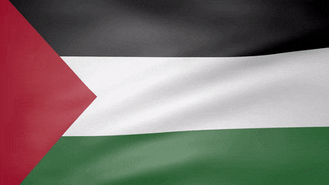
A History of Palestine: 1890-2019
British Colonisation
CONTENTS
Justice for Palestinians
Boycott Divestment Sanctions (BDS)
PSC Campaigns

Slide 3
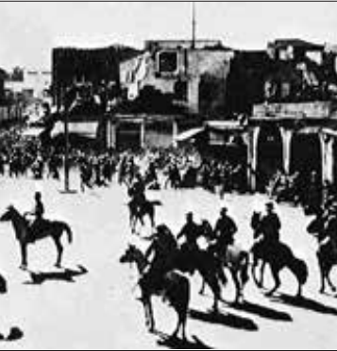
Palestine: A History of Colonisation
1917 Balfour Declaration – issued by British government whilst Palestine still under Ottoman rule
  ‘The establishment in Palestine of a national home for the Jewish people’
  ‘Nothing shall be done which may prejudice the civil and religious rights of existing non-Jewish populations in Palestine’
  ‘Facilitate Jewish immigration under suitable conditions.’
British colonial troops put down a Palestinian protest (1933)

Slide 4
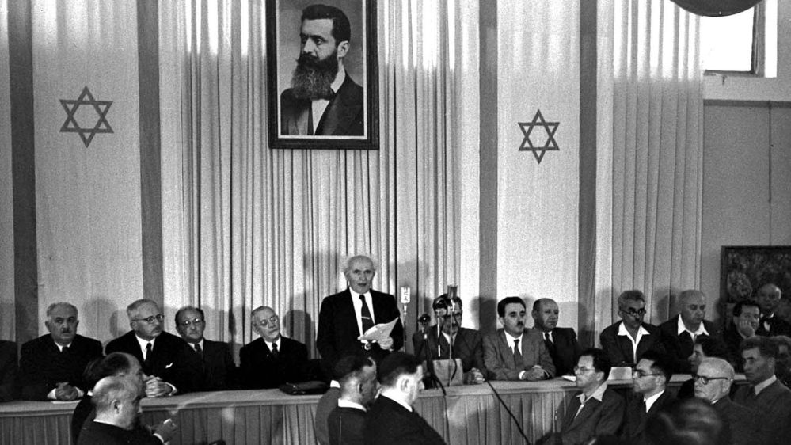
Palestine: A History of Colonisation
After the Balfour Declaration, Britain facilitated the colonisation of Palestine.
[Palestinian] Arab Revolt (1936-39)
  5,000 Palestinian deaths
  Destruction of the Palestinian leadership
  UN Partition Plan (1947) – Britain withdrew
  Nakba (1948). Israel occupies 1/3 more land than assigned by the UN
  Nakba – ‘Catastrophe’ in Arabic - > 700,000 Palestinian refugees expelled or forcibly displaced. Over 530 towns and villages destroyed.

Slide 5
Palestinian Citizens of Israel (1948-1966 and onwards)
After the Nakba, Palestinians who remain in state of Israel are granted citizenship, while those expelled are blocked from returning, and have land expropriated by the new Israeli state.
Until 1966 Palestinian citizens are under martial law. This allows Israeli state to seize their land, and limits the ability of Palestinians to obtain political influence.
This period of martial law facilitates the creation of a system of institutionalised racist discrimination. While both Jewish Israelis and Palestinians have citizenship, rights are assigned based on nationality.
Palestinian nationals face discrimination in every aspect of life, from housing and employment, to education and land ownership.
In the Negev/Naqab, Palestinian Bedouin communities face ongoing dispossession, despite being Israeli citizens.

Slide 6
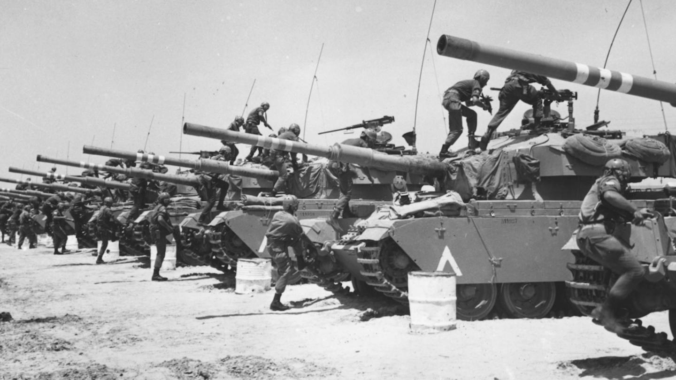
1967 ‘Six Day’ War → Occupied Palestinian Territory
Israel achieves absolute victory over Arab armies.
Significantly, Israel gains control over the remainder of ‘historic Palestine’: East Jerusalem, West Bank and Gaza. These areas are subjected to ongoing military occupation. Israel’s aim is to control and settle as much of the land of historic Palestine as possible and drive as many of the indigenous Palestinian population from the land as it can.
  Israel also seizes control of Sinai Peninsula and Golan Heights. Part of the Sinai is ceded back to Egypt as part of the Israel-Egypt Peace Agreement (1979). The Golan Heights (Syria) remains under Israeli control.
  International law regards the West Bank, East Jerusalem and Gaza (and Golan) as illegally occupied

Slide 7
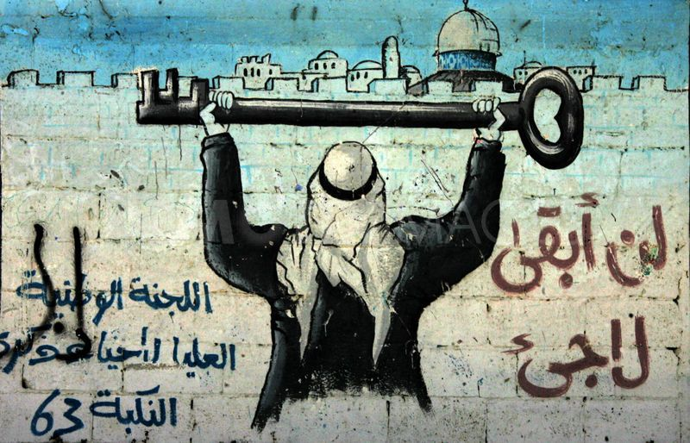
Palestinians in the OPTs
Israelis in the OPT (living in Jewish-only settlements)
Settler communities based on stolen Palestinian land, who are given financial and political support by the Israeli government. Around 700,000 Israeli settlers live on stolen Palestinian land in the West Bank and East Jerusalem.
Subject to Israeli civil law
Palestinians in OPT
  Subject to military law (discrepancy between law for settlers and Palestinians) with 98% conviction rate.
  Insecure residency rights for Palestinians in East Jerusalem.
  No political rights for Palestinians – cannot vote in Israeli elections.
  Face land dispossession, home demolition, arbitrary arrest and detention, settler and state violence etc.
  Tried in Israeli military courts and transferred to Israeli prisons in violation of the Geneva Convention

Slide 8
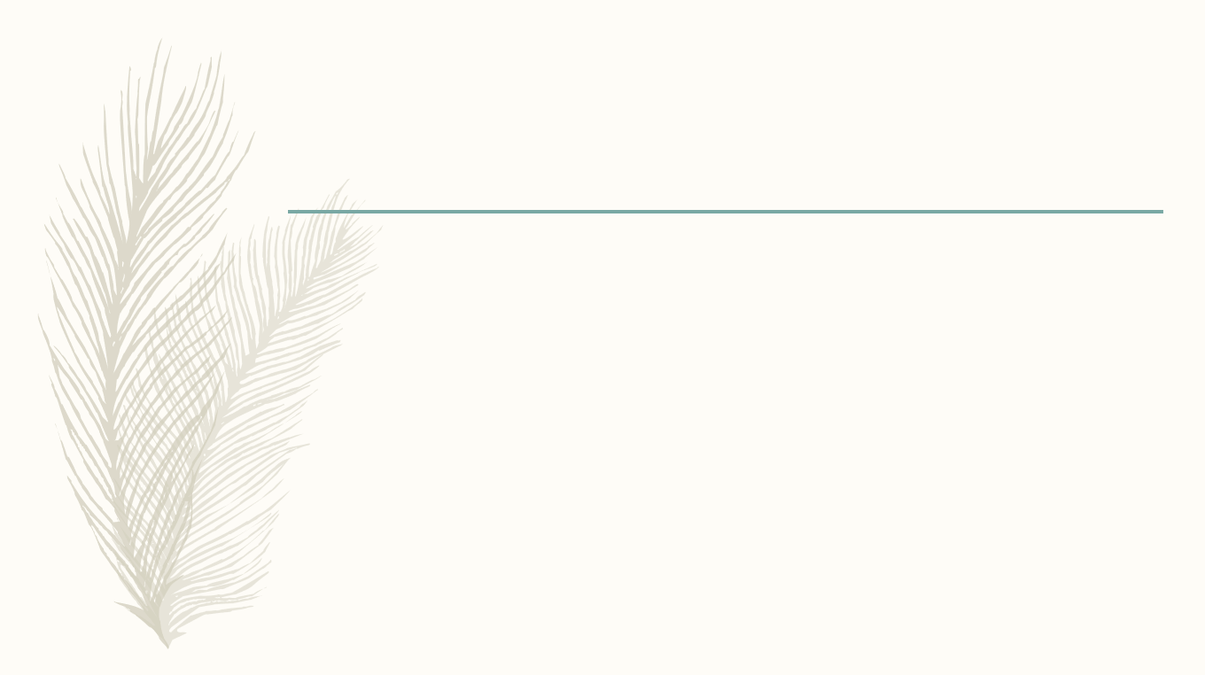
Peace Process (Oslo Accords): 1993
The Palestine Liberation Organisation (PLO) recognises Israel (1988) and the Palestinian Authority is formed in the West Bank as part of the Oslo Accords signed in 1993.
The stated goal of the peace process was to lead to the eventual recognition of Palestinian State. However,
  Was this ever the intention of Israeli leadership?
  Certainly, the illegal settlement of Palestinian land, in violation of the Fourth Geneva Convention, which began in the 1970s - increased markedly.
  There are now over 700,000 settlers in the occupied West Bank and East Jerusalem and the settlement and annexation of Palestinian land continues.
  Illegal military occupation of West Bank, Gaza and East Jerusalem continues. The PA has no sovereignty over land it is assigned to govern.

Slide 9
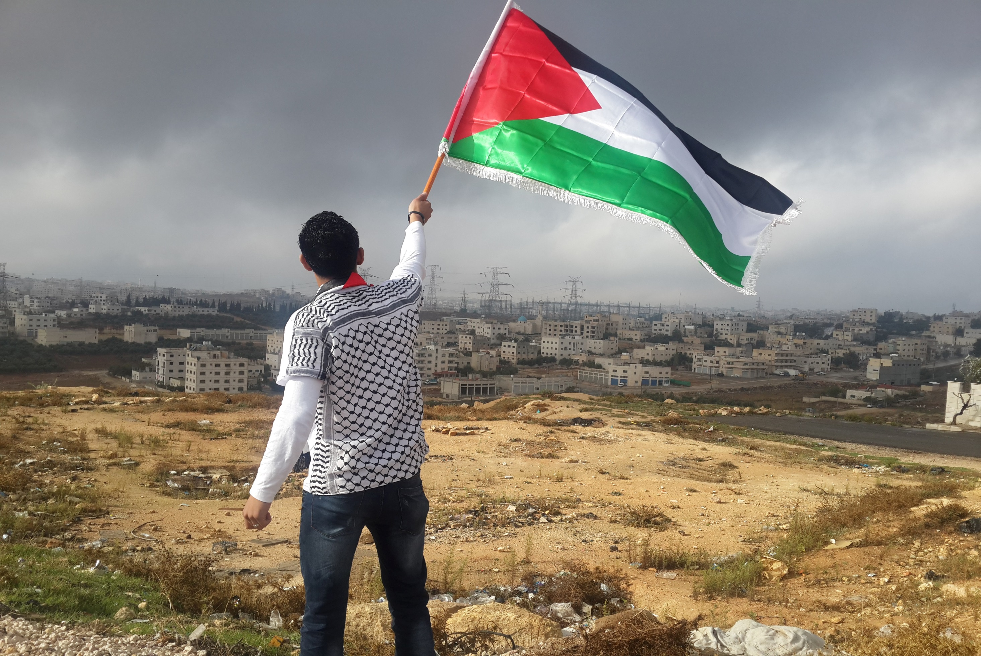
Gaza Under Siege (2007)
In 2005, Israel removes settlers from Gaza, as part of Ariel Sharon’s disengagement plan.
Instead, Israel places Gaza under a suffocating land, air and sea blockade in June 2007.
Gaza is subject to routine aerial bombardment, most recently in 2014, when Israel killed over 2,200 Palestinians, nearly a quarter of them children, in 51 days of terror.
Devastating effects of the siege include the destruction of the Gazan economy, shortage of essential medicines, contamination of water, widespread poverty etc.
In 2012 UN estimates Gaza will be uninhabitable by 2020.

Slide 10
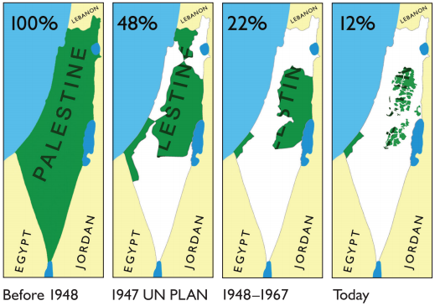
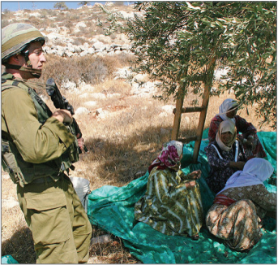
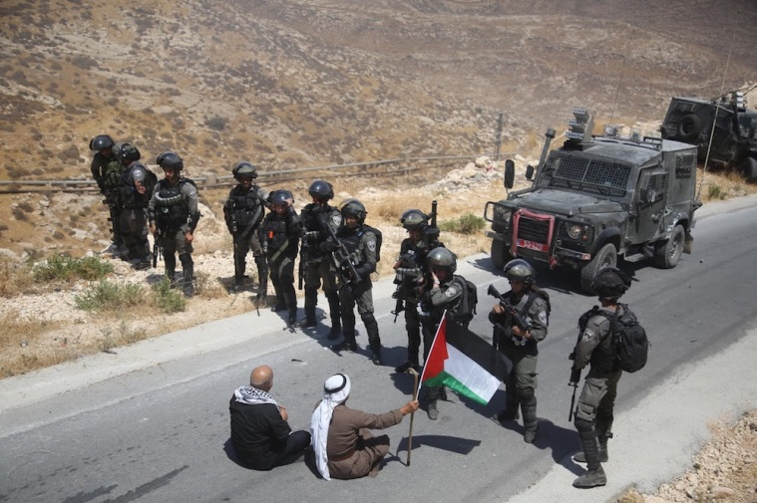
SUMMARY
Palestine (1948-2019)
  Since 1948 Israel has aimed to control and settle as much of the land of historic Palestine as possible and drive as many of the indigenous Palestinian population from the land as it can.
  Palestinians in enclaves as illegal Israeli settlements expand and Palestinian dispossession continues
  Israel controls land, sea & air over historic Palestine. Land and people subjected to a matrix of control and domination, which affects segments of the Palestinian population differently.
  This system of racial discrimination amounts to the crime of apartheid under international law.

Slide 11
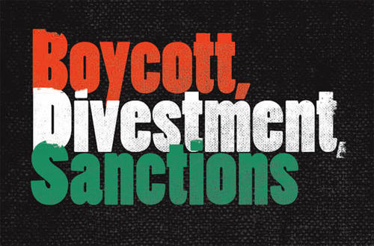

Boycott, Divestment, Sanctions (BDS)
Launch: July 2005
Grassroots movement founded by large coalition of 170 Palestinian civil society organisations, including Trade Unions, Student Groups, Womens’ Groups and other organisations. Calls for boycott, divestment and sanctions targeting Israeli state and complicit companies and institutions. Means of putting pressure on Israel to comply with international law.
Objectives:
  Ending occupation of East Jerusalem & West Bank, lifting siege of Gaza and dismantling the Separation Wall.
  Palestinian Right of Return for refugees and their descendants.
  Equality for Palestinians living in Israel.

Slide 12
Targeting Complicit Companies
Israel can only maintain this system of oppression because of equipment and services it receives from a range of companies. These companies:
1) Supply the Israeli military with weapons and technology
2) Supply, or are active in Israel’s illegal settlements, based on stolen Palestinian land
3) Provide and maintain the infrastructure for Israel’s illegal military occupation

Slide 13





PSC Campaigns: Recent Successes
Divestment from:

Slide 14




PSC Campaigns: Ongoing
Settlement Goods Parliamentary Campaign
University Divestment

Slide 15
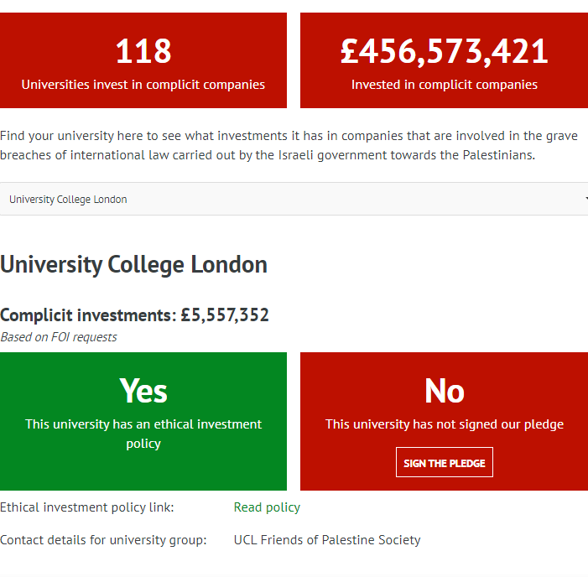
UK Universities
Research by Palestine Solidarity Campaign has uncovered that UK Universities invest over £450,000,000 in companies complicit in Israel’s oppression of the Palestinian people.
Find out the extent of your university’s complicity on our database. https://bit.ly/UniComplicity

Slide 16
Find out more!
Click here to view PSC Youth and Student Committee’s reading list
Watch ‘Roadmap to Apartheid’ free online
Read the BDS Movement’s Introduction to Israeli Apartheid
Watch ‘An Animated Introduction to Israel and Palestine’ by Jewish Voice for Peace
Read PSC’s factsheets on a range of issues
Take action! Use this 10-step BDS guide to start a campaign on your campus!
E-mail lewis.backon@palestinecampaign.org for support, resources and advice for your student group.

